Slide 1
Popularity and applicability of backend development programming languages.
M.M. Wichrowski - 18136753

Slide 2

Notes:
About me, incubeta, the team and what we do.

Slide 3

Notes:
Let’s rewind the clock

Slide 4

Notes:
Context on why this is important to us

Slide 5
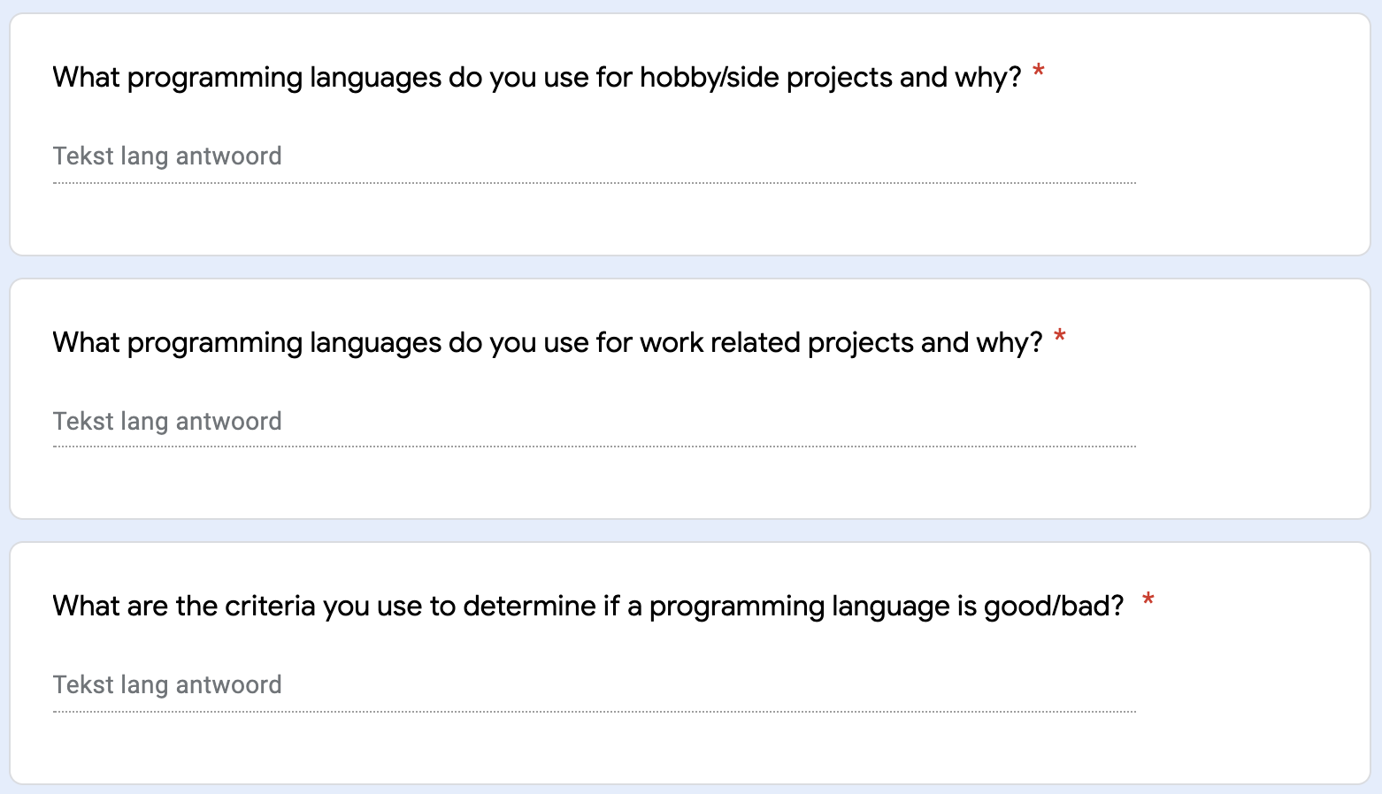
Notes:
Exploration and finding the right track

Slide 6
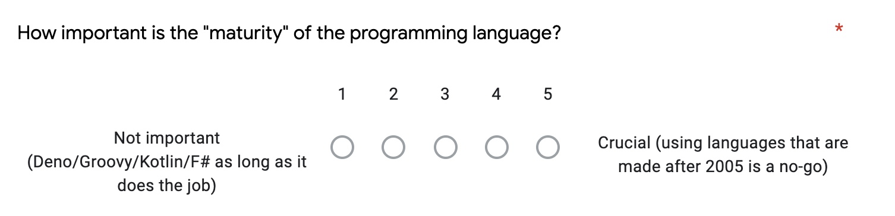
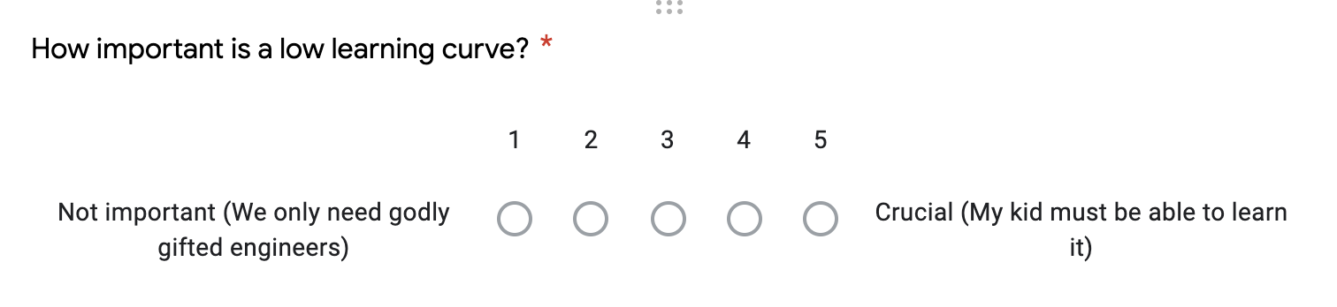

Slide 7
Notes:
fast forward a few more weeks

Slide 8
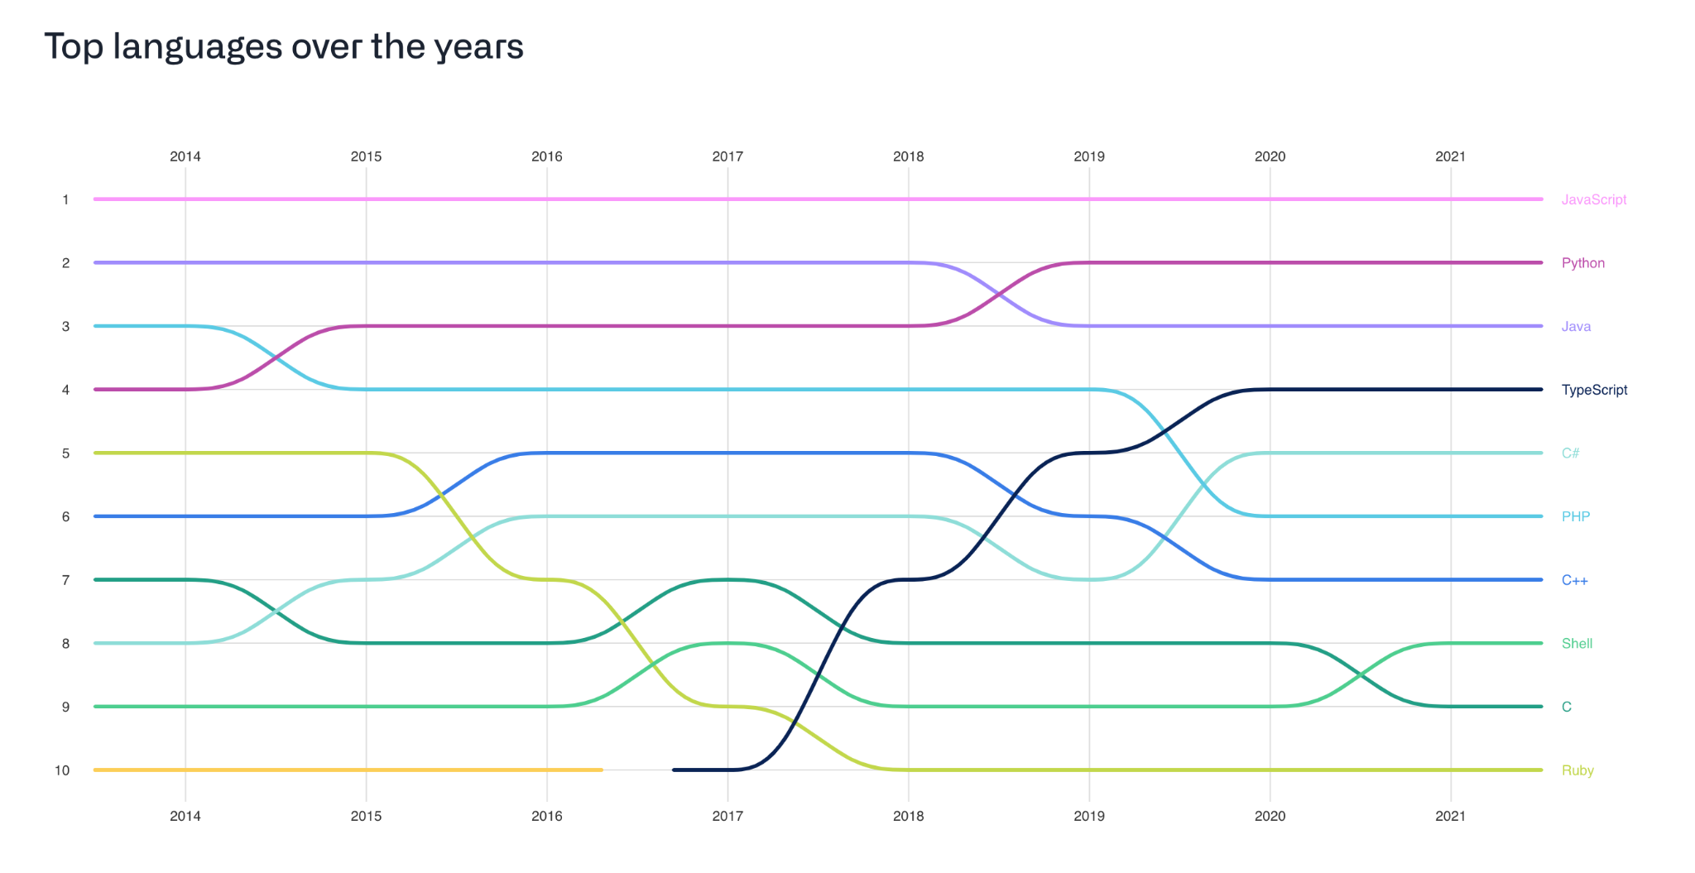

Slide 9
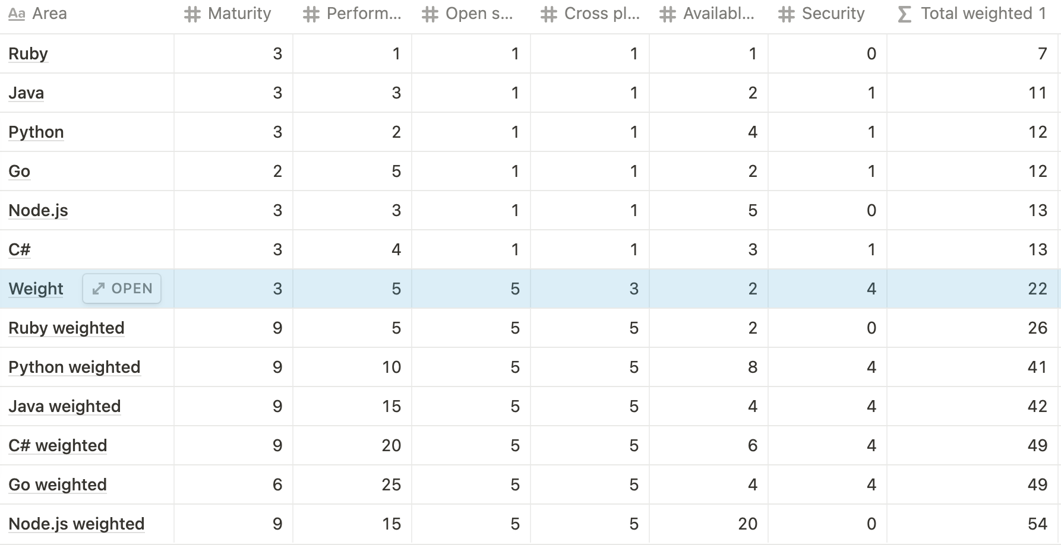

Slide 10
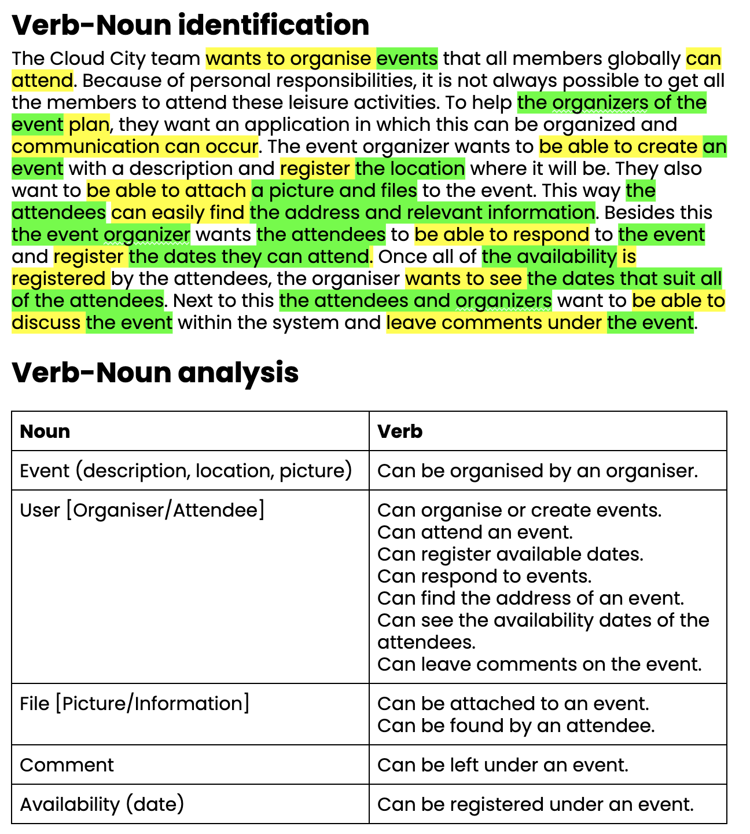

Slide 11
Notes:
Now the pressure is on

Slide 12
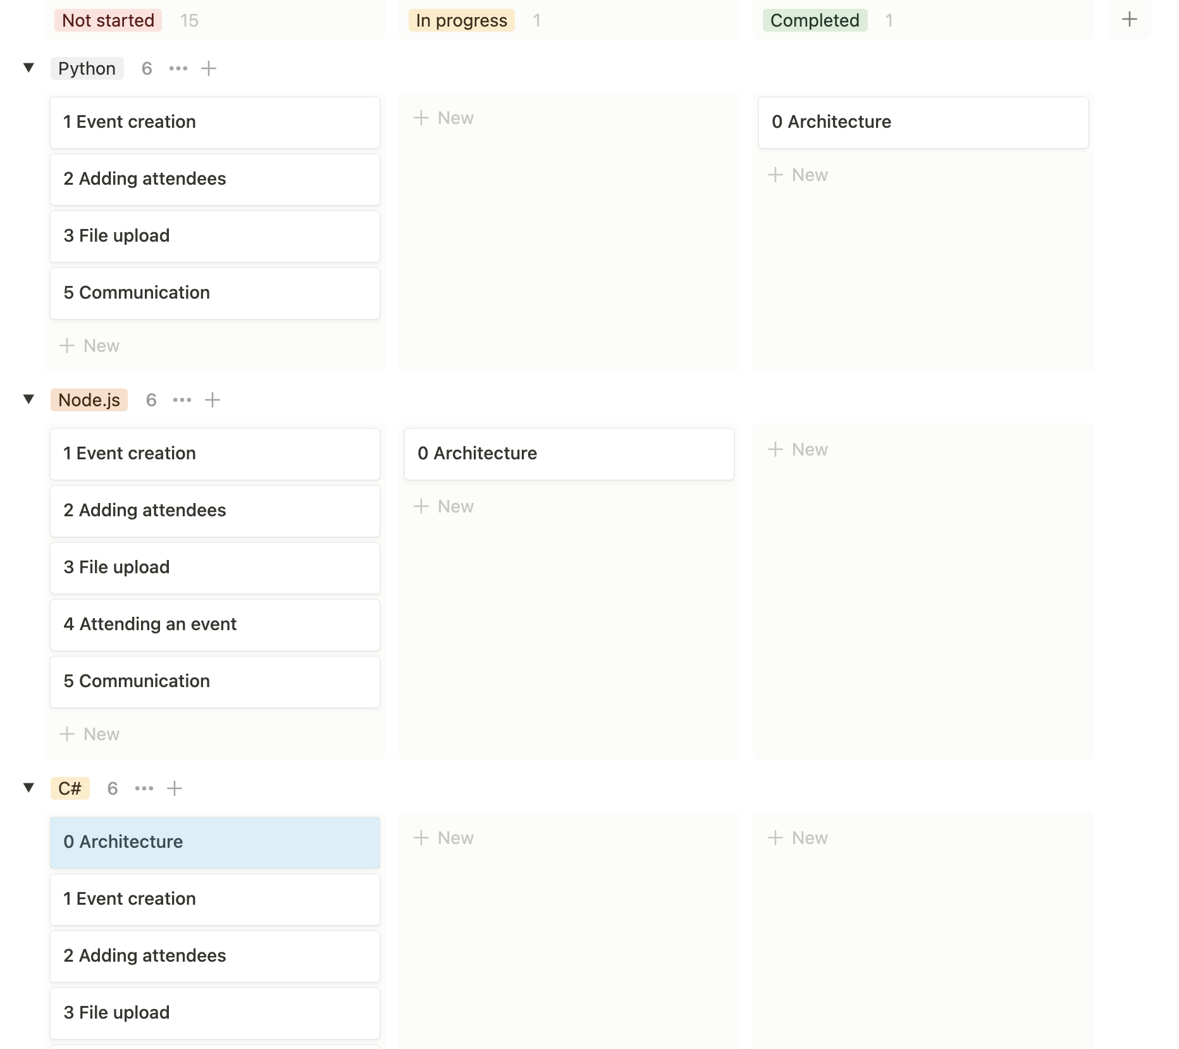
Notes:
Tell about the kanban approach

Slide 13

Notes:
The amount of intimidating information

Slide 14



Notes:
Luckilly i had three experienced developers who could help me learn the correct things. With feedback and by answering the countless questions i would ask them.

Slide 15
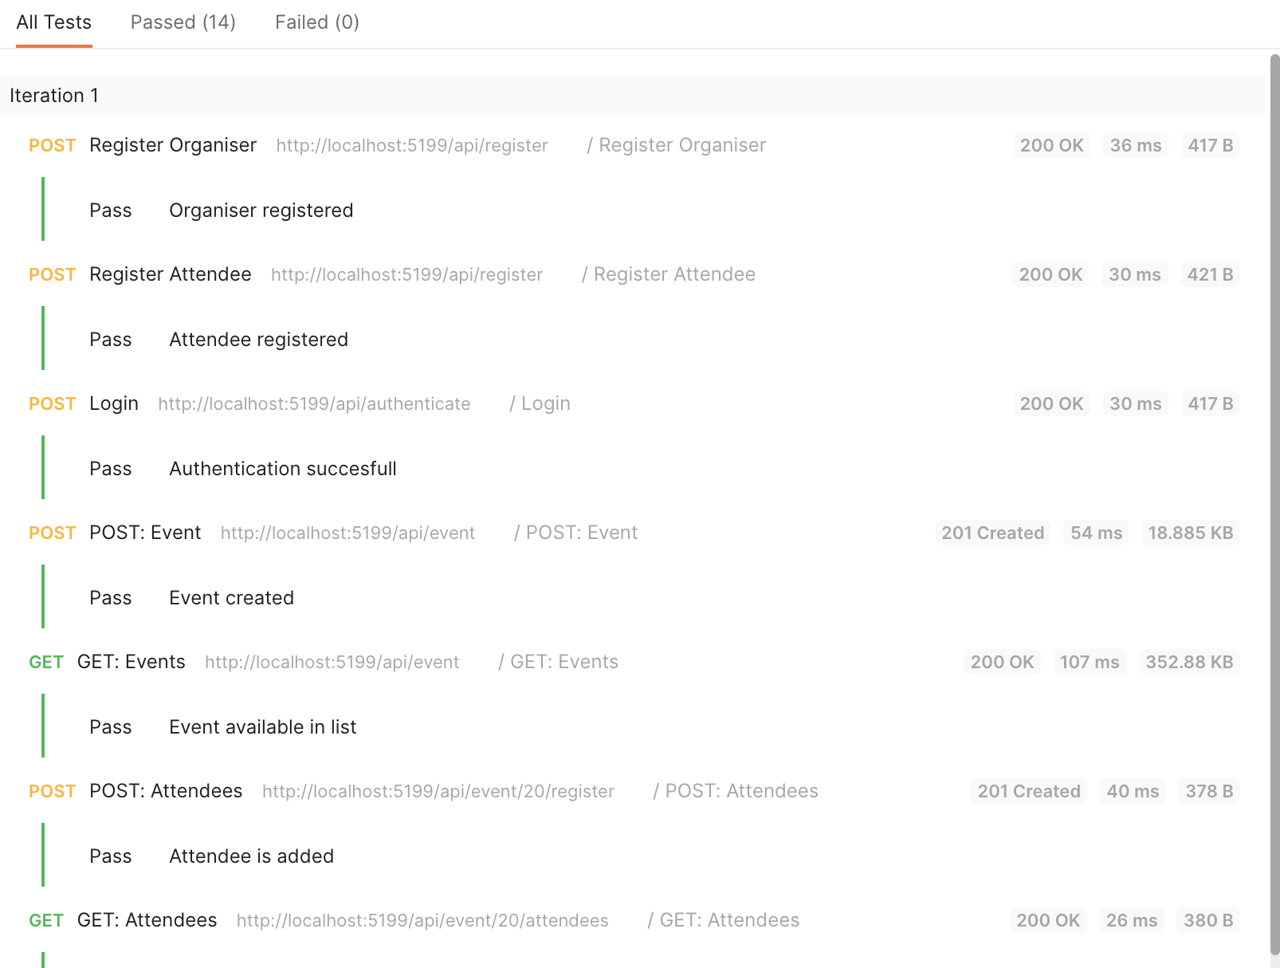
Notes:
Quality assurance

Slide 16
Notes:
The clock is ticking, not much time left but

Slide 17
